Slide 1

CONTENTS
Economics of Testing
How Testing is conducted
Software Testing(then)
Software Testing (now)
Scope of software testing
Factors influencing the Scope of Testing
Risk based Testing
Project Risks
Product risks
Need of Independent Testing
Activities in Fundamental Test process
Attributes of a good tester
Psychology of testing
Code of Ethics for testing
Limitations of Software Testing

Slide 2




The Economics of Testing
Objectives
• Understand where defects originate
• Learn about the 1:10:100 rule
• Learn how to make the most of your testing investment.
Synopsis
This module discusses why software defects are costly to find and fix. You will also learn how early defect detection can save much cost in fixing defects.
Table of Contents
The Economics of Testing
• Where defects originate
• Where testing resources are used
• The relative cost of fixing defects
• The bottom line

Slide 3
The Relative Cost of Fixing Defects
One of the most well known facts about software defects is that the longer they go undetected, the more expensive they are to fix. Although research differs on the exact ratios, the general rule is 1:10:100.
That is, if a defect costs one unit (hour, dollar, etc.) to fix in requirements and design, it costs 10 units to fix in testing (system/acceptance) and over 100 times to fix in production. Sometimes the cost to fix a defect in production costs much more than 100 times the cost of fixing it in the requirements phase.
The Bottom Line
If you want to reduce the cost of testing, spend time early in the system development (or purchase) process to make sure the requirements and design are correct

Slide 4
Where Defects Originate
To understand the dynamics and costs of defects, we need to know some things about them. One of the most commonly understood facts about defects is that most defects originate in the requirements definition phase of a project. The next runner-up is the design phase.
Some problems in getting accurate, clear, and testable requirements are:
• Many people do not have a solid requirements gathering process
• Few people have been trained in or understand the dynamics of requirements
• Projects, people, and the world around us change very quickly
• The English language is ambiguous and even what we consider clear language can be interpreted differently by different people.
Where Testing Resources are Used
We saw that most defects originate in requirements and design, but most of the testing effort occurs in a traditional “testing” phase toward the end of the project. This is called the “big bang” approach from the concentration of effort at one big phase. “Big bang” could also describe the sound of the project as it fails.
The problem with the big bang approach to testing is that defects are not found until toward the end of the project. This is the most costly and risky time to fix defects. Some complex defects may even be impossible to fix.

Slide 5
HOW TESTING IS CONDUCTED
Testing is based on external expectations - Internal behavior of the application is unknown. Testing is done on the basis of high-level database diagrams and data flow diagrams. Internal workings are fully known and the tester can design test data accordingly.
5 key software testing steps every engineer should perform
1.Basic functionality testing. Begin by making sure that every button on every screen works.
2.Code review. Another pair of eyes looking at the source code can uncover a lot of problems.
3.Static code analysis.
4.Unit testing.
5.Single-user performance testing.

Slide 6
SOFTWARE TESTING-THEN (PAST)
Testing was done by team according to the people choice
Lack of technology
There are less professions for testing due to lack of technical knowledge
Testing was learned by less people
All testers were expected to know programming languages and understand the working principles of operating systems.

Slide 7
SOFTWARE TESTING-NOW (PRESENT)
•Technology was improved
•Each tester has technical knowledge
•Testing was done separately by each person in a team
•Testing was not done in a huge way

Slide 8
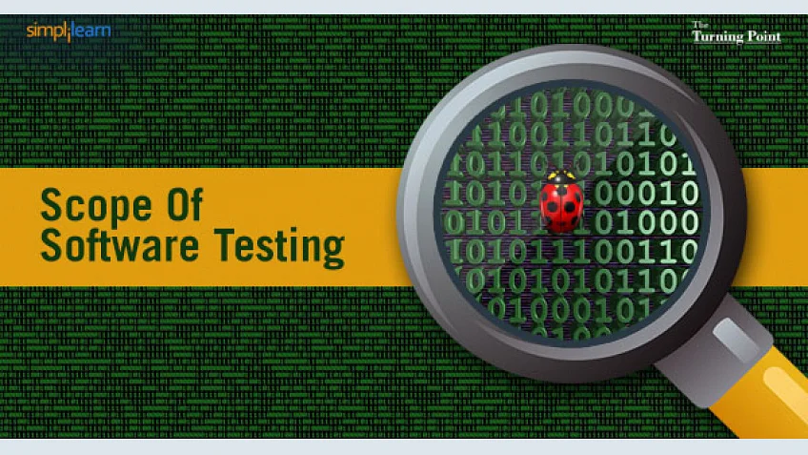
SCOPE OF SOFTWARE TESTING
The scope of software testing includes:
Execution of that code in various environments and scenarios.
Examine the aspects of the code: Does the software do perform the executed task Function according to the specified...
Does the software do perform the executed task
Function according to the specified functionality.
A tester must know the program to be tested and the tools needed to test it. It is frequently very specialized, and your employer may be required to train you. To be an effective tester, you must be well-organized, rational, careful, thorough, and patient.

Slide 9
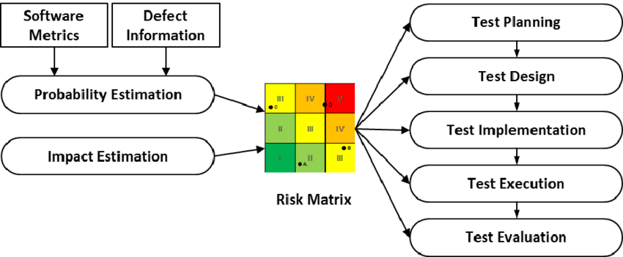
Risk Based Testing
Risk-based testing is prioritizing the feature’s, modules and functions of the Application under Test based on impact and likelihood of failures. It involves assessing the risk based on the complexity, business criticality, usage frequency, visible areas, Defect prone areas, etc.
Positive risks are referred to as opportunities and help in business sustainability. For example, investing in a new project, changing business processes, Developing new products.
Negative Risks are referred to as threats and recommendations to minimize or eliminate them must be implemented for project success.
When to implement Risk-based Testing
Risk-based testing can be implemented in
Projects having time, resource, budget constraints, etc.
Projects were risk-based analysis can be used to detect vulnerabilities to SQL injection attacks.
Security Testing in Cloud Computing Environments.
New projects with high-risk factors like Lack of experience with the technologies used, Lack of business domain knowledge.
Incremental and iterative models, etc.

Slide 10
Risk-Based Testing Approach
Analyze the requirements.
Documents (SRS, FRS, Use cases) are reviewed. This activity is done to find and eliminate errors & ambiguities.
Requirements sign-offs is one of the risk-reduction technique for avoiding the introduction of late changes into the projects. Any changes to requirements after the document are baseline would involve a change control process and subsequent approvals.
Assess the risks by calculating the likelihood and impact each requirement could have on the project taking the defined criteria’s like cost, schedule, resources, scope, technical performance safety, reliability, complexity, etc. into consideration.
Identify the probability of failure and high-risk areas. This can be done using the risk assessment matrix.

Slide 11
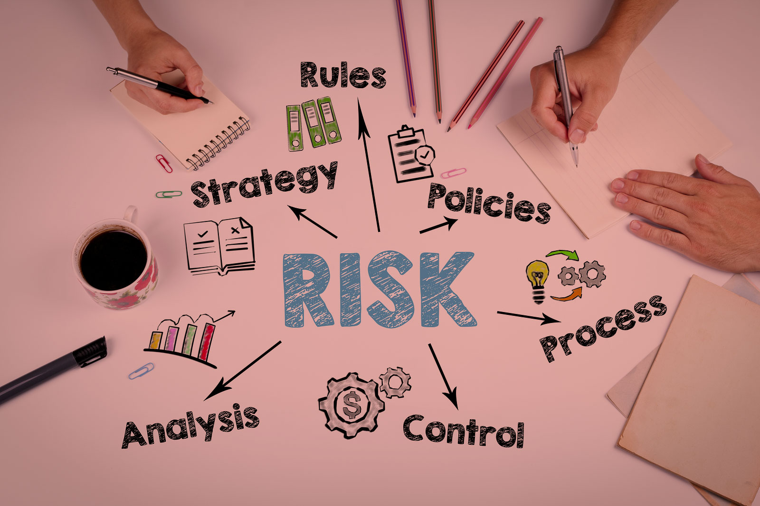
Project Risks
1.Project purpose and need is not well-defined.
2.Project design and deliverable definition is incomplete.
3.Project schedule is not clearly defined or understood.
4.No control over staff priorities.
5.Consultant or contractor delays.
6.Estimating and/or scheduling errors.
7.Unplanned work that must be accommodated.

Slide 12


PRODUCT RISK
Product risk is the set of things that could go wrong with the service, software or whatever is being produced by the project. In the same way that project and business risks are quantified (using likelihood and impact) product risks should also be categorised and measured. The main difference with a product risk is that it is normally, but not always, mitigated by appropriate testing (in contrast, a project risk cannot be mitigated by testing).
Product risks can be classified in many ways but they fall into one of two main categories, functional and non-functional. Functional risks relate to how the product may not achieve the activities it is designed to do, such as receiving data, performing calculations, producing reports and interfacing with other systems. Non-functional product risks relate to such possible problems as not performing a (correct) calculation quickly enough or being unstable with a high number of concurrent users.

Slide 13
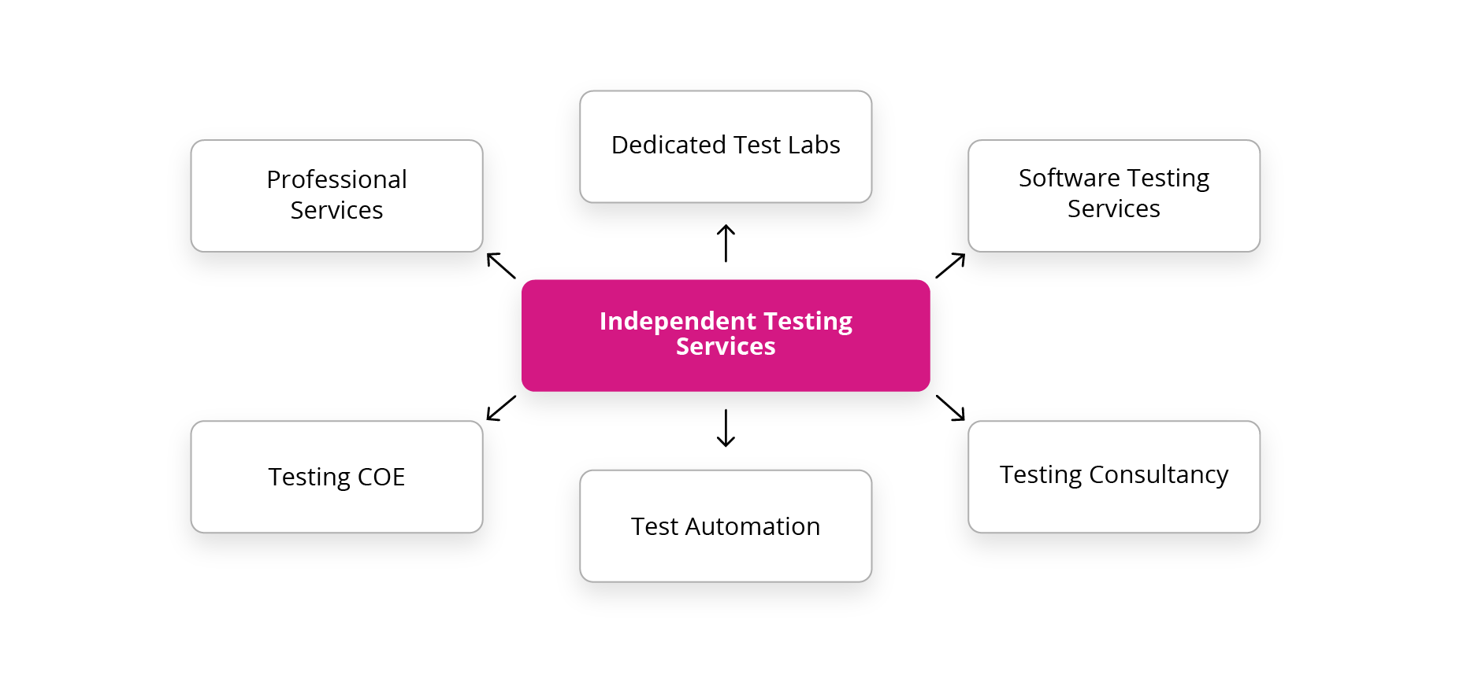
Independent Testing
Key Advantages of Independent Testing
Independent testing has an upper hand over traditional testing in many ways. Let’s take a look at some of the key advantages that it offers:
Improved Software Quality – One of the top benefits of outsourcing testing to independent testing organizations is improved software quality. Independent testing teams engage in a bias-free procedure and make sure that the product is developed according to customer requirements and meets the desired objectives while maintaining high quality.
2.Experienced and Skilled Manpower – Independent testing organizations have experienced and skilled manpower to carry out testing activities in the best possible manner. They hire the best of talent across various testing domains like automation testing, manual testing, load testing, security testing, etc.
3. Lower Life Cycle Costs – Organizations that employ independent testers can focus exclusively on quality and adherence to requirements and maintainability and scalability to address future needs. This ensures low failure rates and reduced maintenance costs. Rigorous testing cycles for both functional and non-functional aspects like performance and stress handling is covered.

Slide 14

Attributes For A Good Tester
Positive Attitude. A positive attitude is a key agent to succeed in any field and Software Testing is not an exception.
Good Communication. It helps to overcome critical problems easily. You can understand problems easily, document better and convince effectively.
Multi-Tasking Abilities. Multi-tasking abilities are the demand of today’s era. Work on multiple projects and provide updates.
Quick Learner. A great tester is a quick and self-learner. You do not HAVE to learn new stuff, you should WANT to learn it.
Passion For Testing. You have got to love your job. A passion for delivering quality, for providing better user experience, for generating new ideas, etc. is critical.
Team Player. Being a team player is a must for every job but it takes on a whole new dimension because we have to deliver bad news.

Slide 15
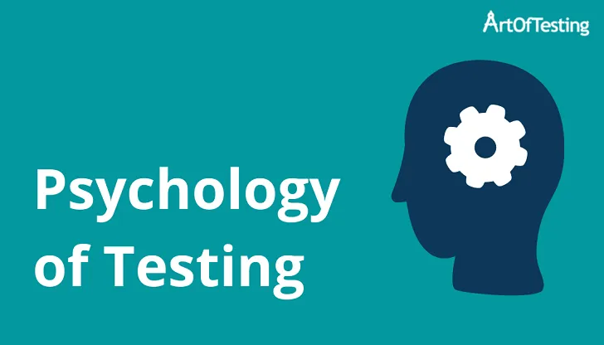
Psychology of Testing
The Mindset of Developers and Testers. Before we start the discussion on this topic, it is important to note that developers also do the testing of the system.
Polite and Clear Communication. As discussed earlier, testers find mistakes or errors in the system and communicate these findings with the developers.
Test Independence.

Slide 16

CODE OF ETHICS FOR A TESTER
For the first case, the Code of Ethics says: “Software testers shall be fair to and supportive of their colleagues, and promote cooperation with software developers.” On the other hand, it also has this: “Software testers shall maintain integrity and independence in their professional judgment.”

Slide 17
^{Software Testing Limitations}
^{Software Testing Limitations}
We use testing to disclose many hidden errors but this methodology never guarantees the absence of errors. It is only used to identify the known errors. ...
Testing do not provide you any help when you have to make a decision either “you should release the product consisting errors for meeting the deadline” or “you should release ...
Software testing does not predicts or estimate the proper functioning of the product under different conditions, but it may prove to be helpful in delivering the information w.r.t. ...
While injecting the defects, software testing unable to find the root causes which may help in placing defects at the first place. ...
Testing cannot be done against system requirements. We also cannot detect any errors in requirements or ambiguous requirement leads the complete testing process to inadequate testing.

Slide 18


